Slide 1
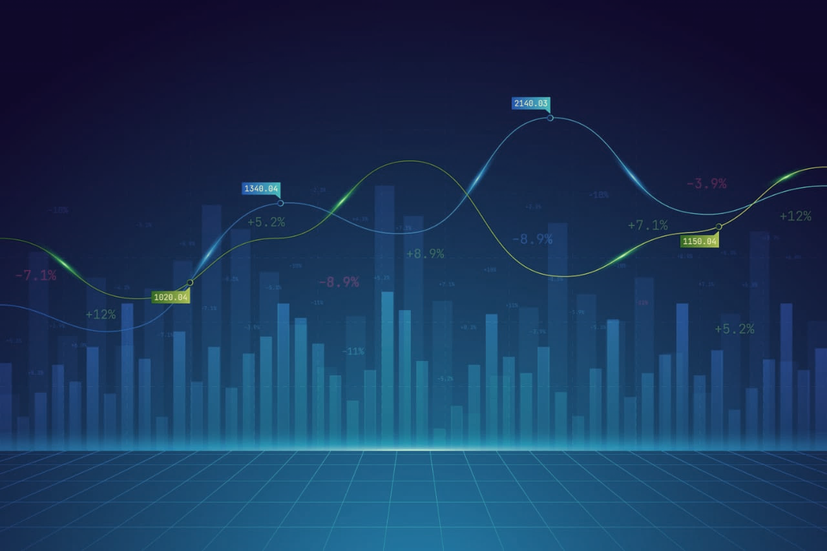
SOLAR PANAL-REGRESSION
[P599]

Slide 2
Gggnbbbbbbbbbccccccccvvvvvv
Project Mentor Mr. Adhvaith
Project co-mentor: Ms.abirami
:
Team Members
:
1. Tharun P
2. Shyam sundar Konchadi
3. Chatla Yashwanth Mallik
4. Vishal Rathod
5. Guruprasad Biradar
6. Karthik Atluri
7. Krishnakant Sanjay Dhotre

Slide 3
Agenda:
Problem statement & objectives
Dataset & exploratory data analysis (EDA)
Data cleaning & preprocessing
Feature extraction
Model building & evaluation
Deployment & conclusions

Slide 4
Project Overview :
Project Title: Solar panal - regression.
Domain: Machine Learning (Regression Model).
Problem: Automatically predict solar power generation using environmental and meteorological variables to help optimize energy planning and efficient utilization of renewable resources.
Approach: Develop a supervised machine learning regression model to predict the solar power generated using environmental features.

Slide 5
Objective:
Primary Goal: Develop a robust classification model that accurately predicts solar power generation using key environmental and meteorological variables such as temperature, humidity, sky cover, visibility, wind parameters, and atmospheric pressure .
Key Deliverables: A clean, well-processed dataset ready for modelling ,multiple regression models, a finalized high-accuracy model saved as deployable python file.
Success Metric: Maximized regression performance measured using r-square score, lower RMSE, and lower MAE, on the final chosen model to ensure accurate and reliable power generation predictions.

Slide 6
Data Overview:
Source: Data loaded from the file dataset- P599.
xlsx –solar power generation .csv.
Initial Size: Approximately 2920 rows and
10 columns.
Key Columns:
* Title: Review title.
* Body: distance to-solar-noon (Primary Feature),wind direction, wind speed.
sky cover, power generated.

Slide 7
System Workflow Diagram :
S[DATA SOURCES]
|
[DATA INGESTION/STORAGE]
|
[DATA PREPROCESSING & CLEANING]
|
[EXPLORATORY DATA ANALYST]
|
[FEATURE ENGINEERING/SELECTION]
|
[MODEL TRAINING & HYPERPARAMETER TUNING]
|
[MODEL EVALUATION & COMPARISON]
|
[SELECTED MODEL(SERIALIZE MODEL.PKL/JBL)]
|
[DEPLOYMENT:REST API(STREAMLIT,FLASK)]
|
[MONITORING,LOGGING,RETRAINING & SCHEDULED]

Slide 8
Exploratory Data Analysis (EDA):
Data Quality: Checked for and confirmed no missing values Removed duplicate rows.
Visualization: By using histplot ,boxplot, heatmap, scatter plot we explored how the data is distributed
Outlier capping : by using boxplot we explored that is there any outliers or not ,if exists we get rid of from them by using capping.

Slide 9
Feature Engineering :
Select the features for modeling
Split the data
Scale the features
Saved the scalar & .joblib models

Slide 10
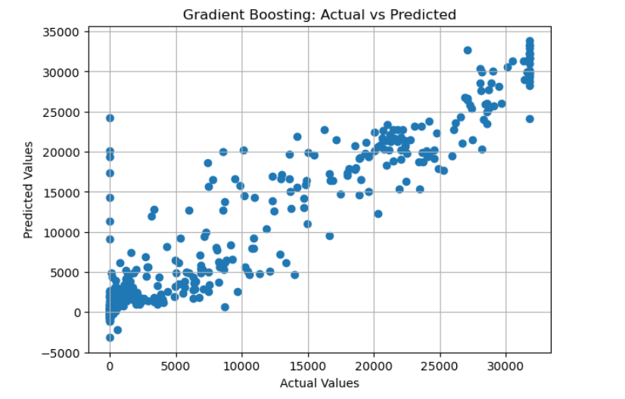
Model Building & Testing:
Split dataset into 80% training and 20% testing.
Tried multiple models:
Gradient Boosting.
XGBoost .
Random Forest.
Decision Tree.
Trained each model and evaluated using RMSE,MAE, R-square .
Selected the best-performing model based on results.
We came up with the best model which gives best results is “gradient boosting”

Slide 11
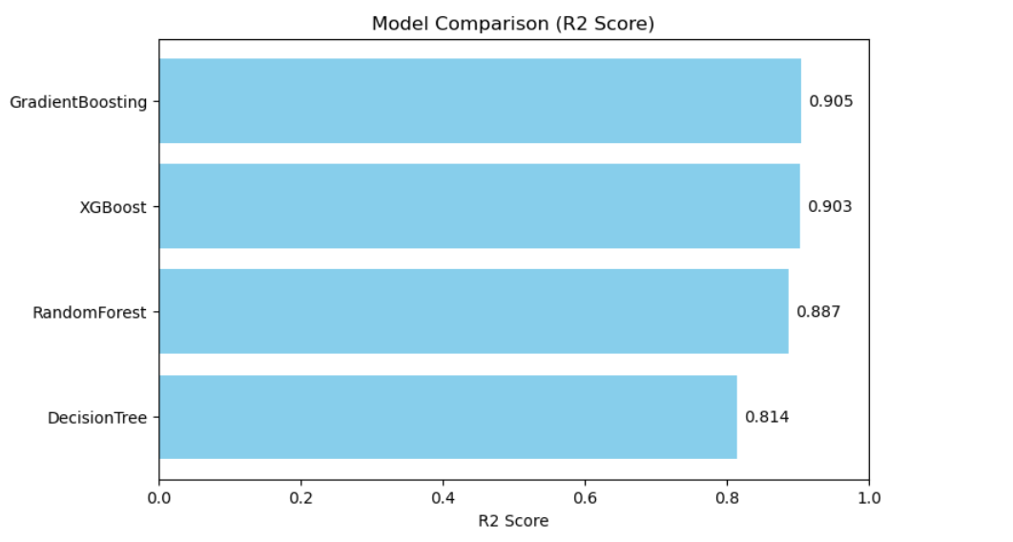
Best Model:
After testing multiple models such as XGBoost, Random Forest, and Gradient boost, decision tree . The Gradient Boosting model achieved
the best overall performance.
Reasons for Selecting Gradient boosing :
Delivered the highest R-square & RMSE
among all tested models
Robust for small to medium-sized datasets
Easy to interpret, tune, and deploy
Performance Metrics:
R-square : ≈ 0.905%
RMSE: ≈ 3106.00%
MAE: 1633.37%

Slide 12
Deployment:
Export model (pickle / job lib or saved transformer model).
Wrap inference in an API (/streamlit/Flask / FastAPI)
Monitoring: track R-square,RMSE, MAE

Slide 13
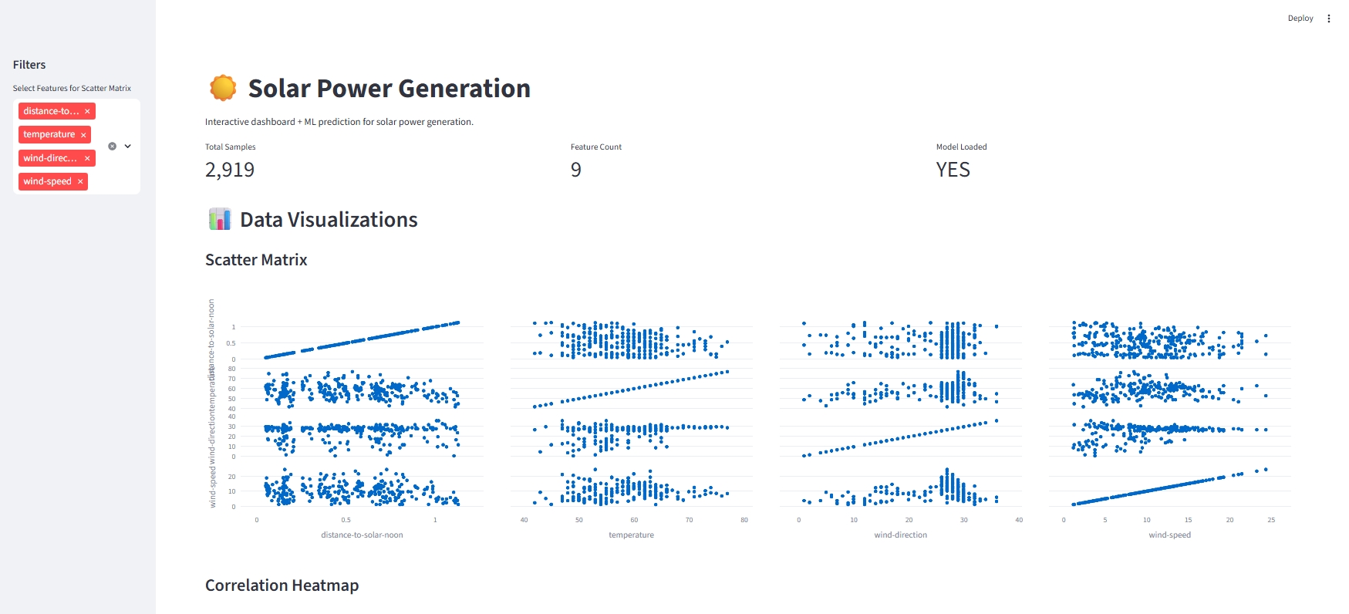
Deployment: Output

Slide 14
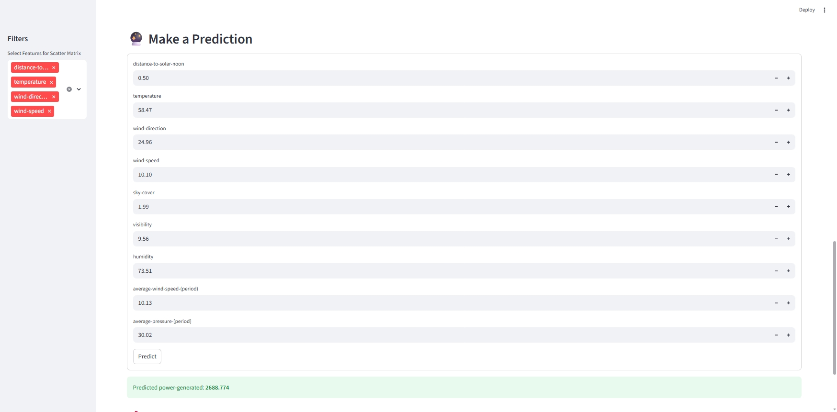
Deployment: Output

Slide 15
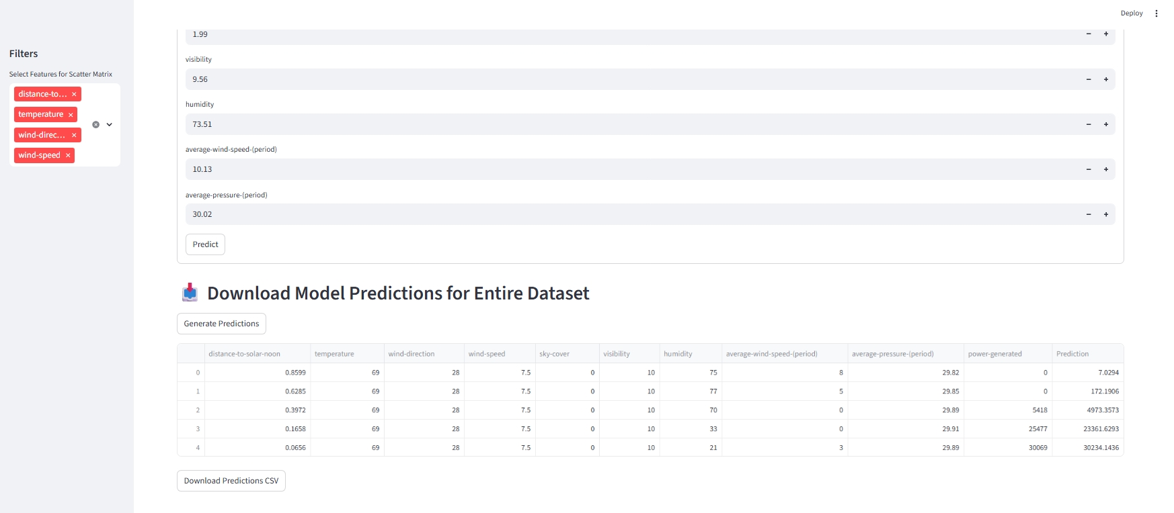
Deployment: Output

Slide 16
Challenges Faced:
Data Quality Issues
Data Granularity & Time Intervals.
High Variability in Weather Conditions.
Feature Correlation & Multicollinearity.
Model Overfitting.
Limited Historical Data.
Deployment issues — dependency errors and environment setup.
Limited time and computing resources.
Non-Linear Relationships
Interpretability

Slide 17
Thank You

